Slide 1
EnglISH PRESENTATION
Umut Dogru 11&B 405

Slide 2
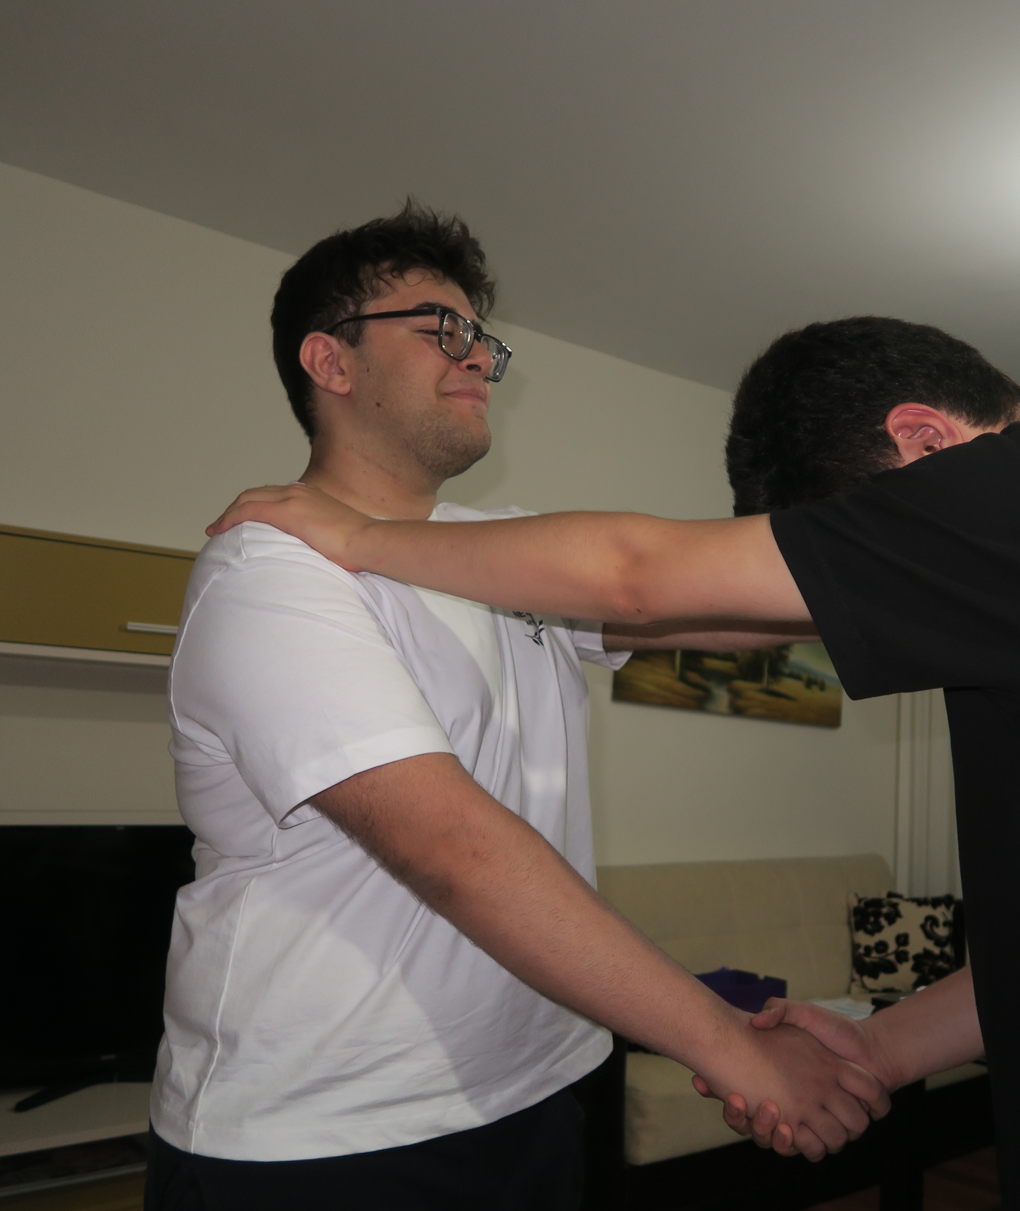
He is so helpful

Slide 3
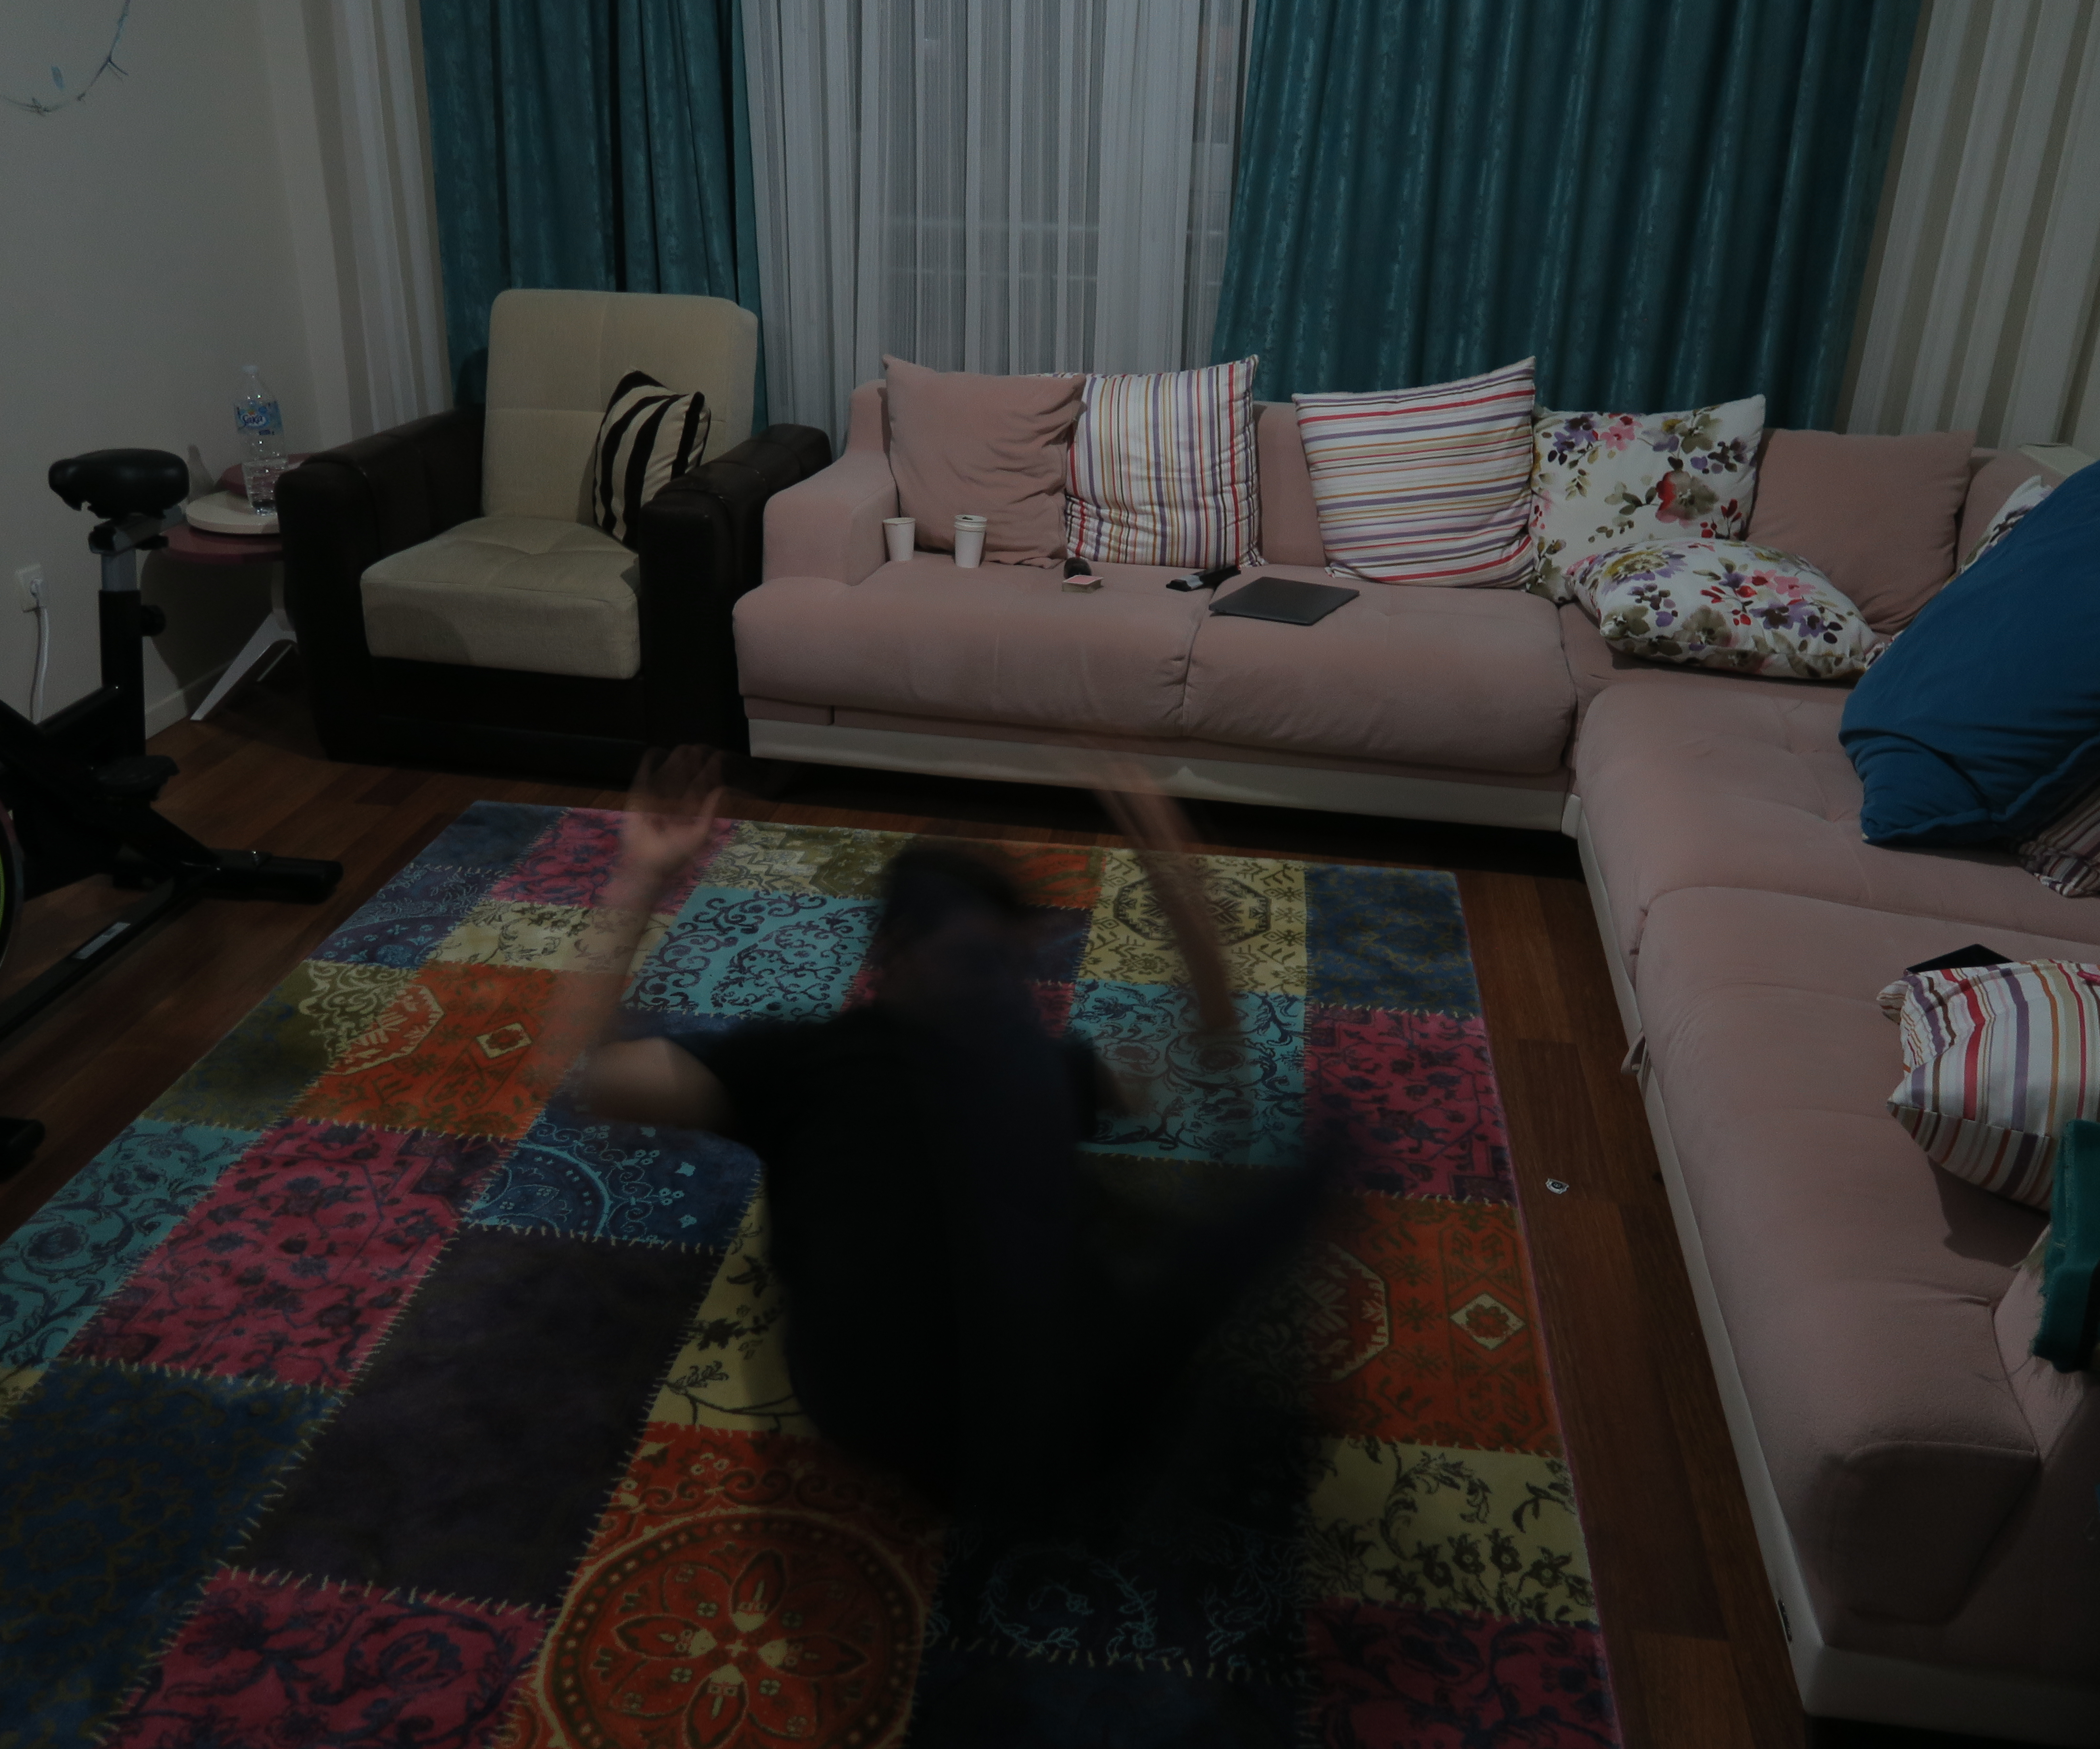
He is very crazy (adventure)

Slide 4
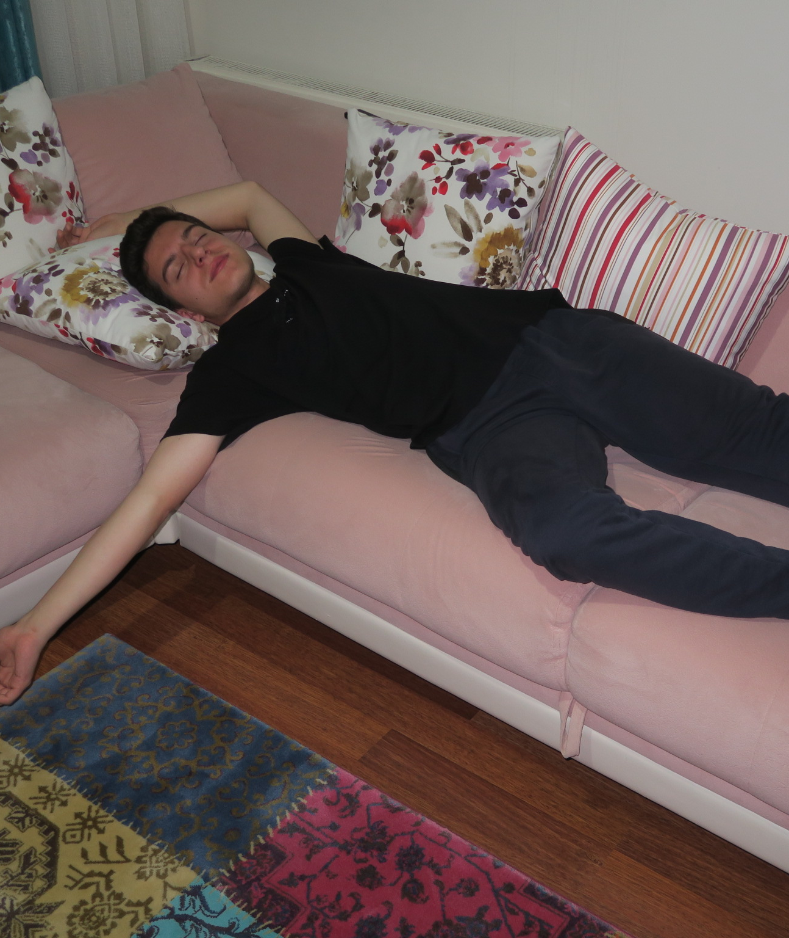
He is so lazy

Slide 5
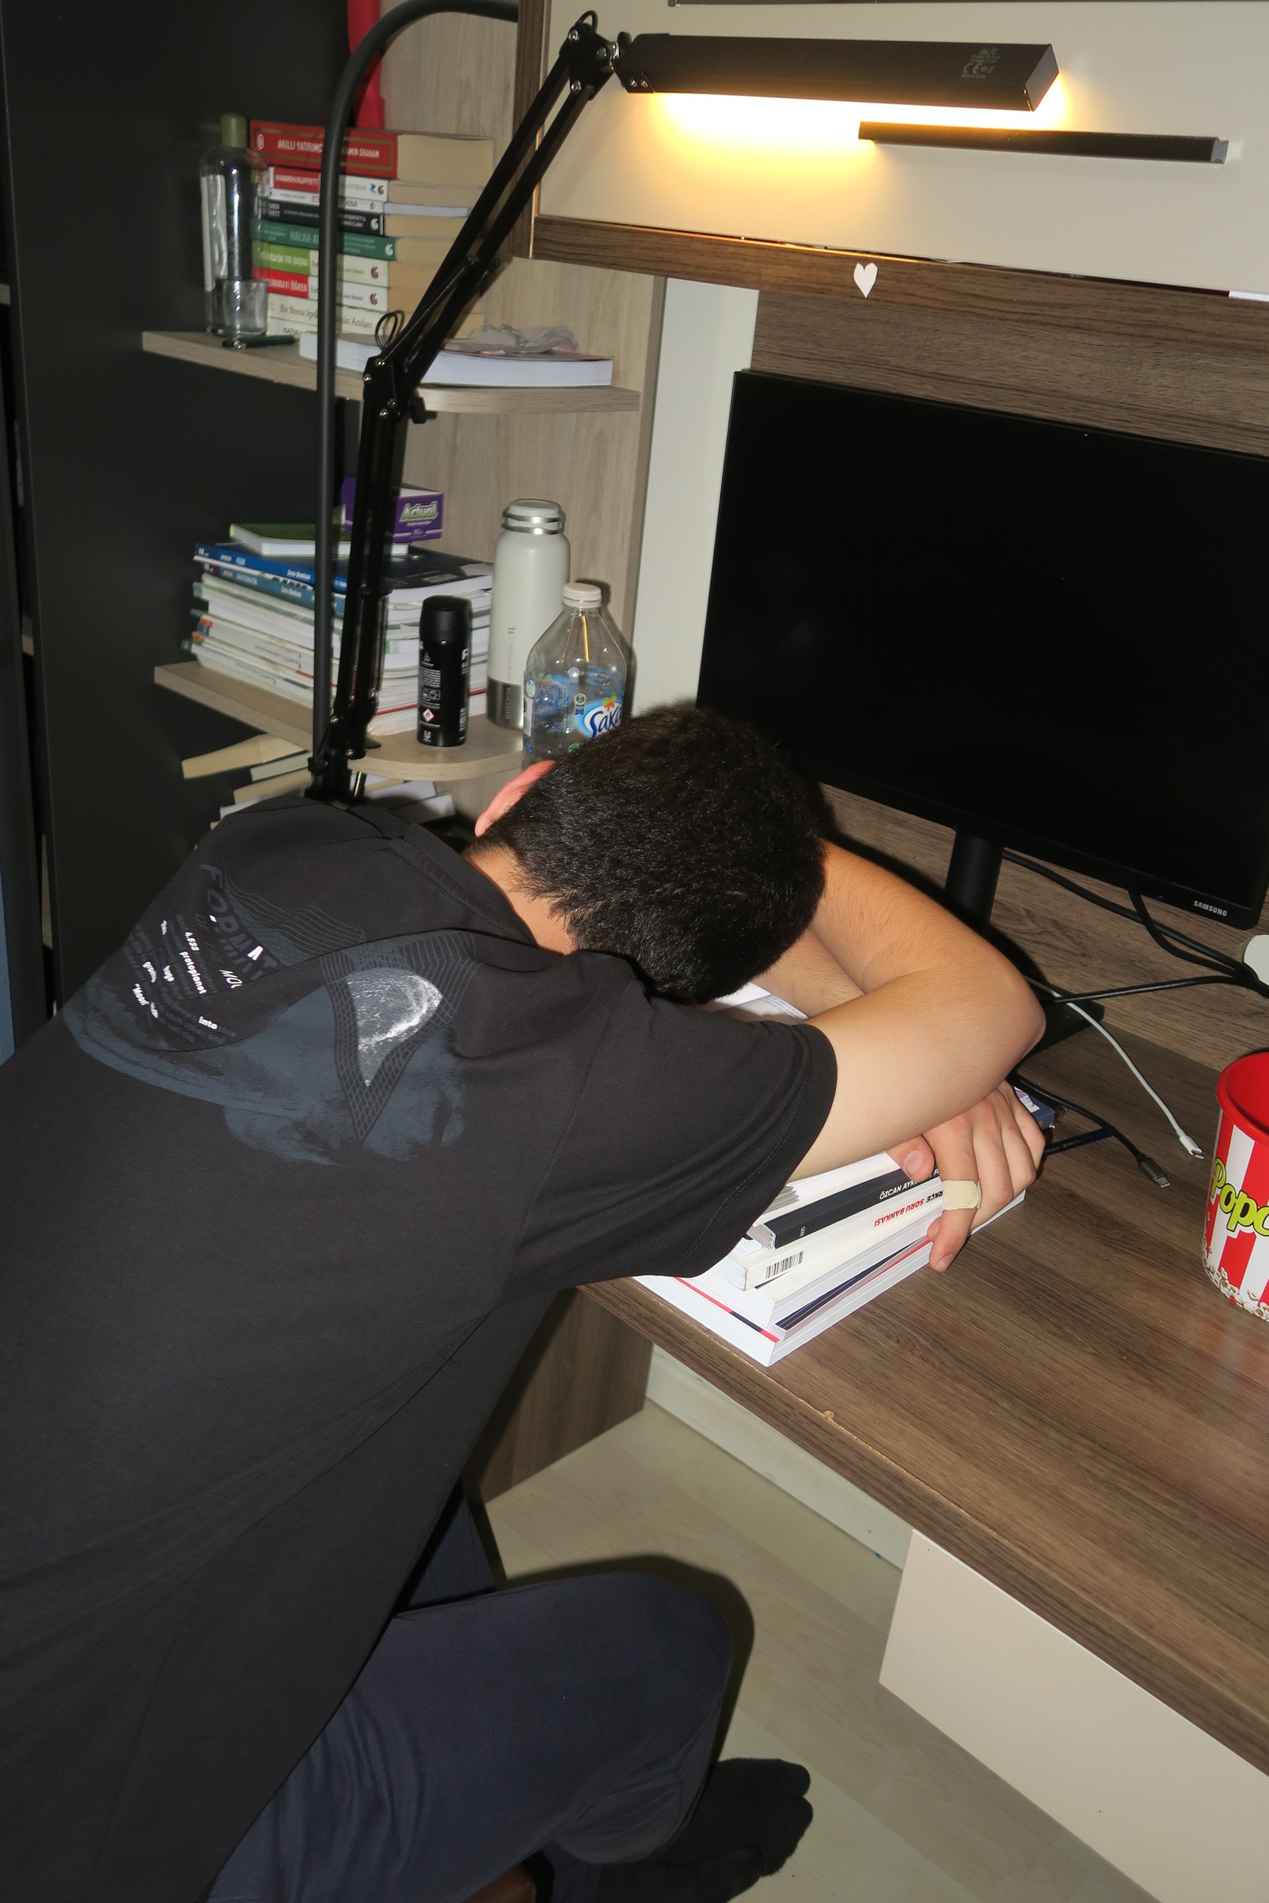
He is a great student (Hardworking)

Slide 6
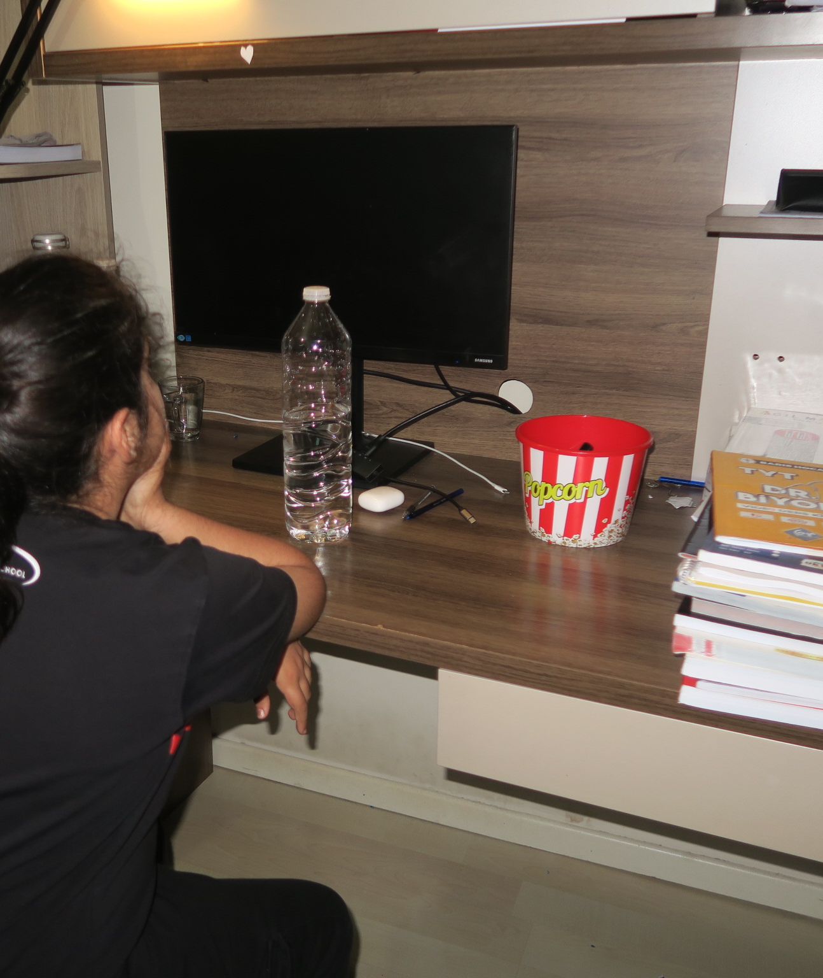
She is a optimist

